Slide 1

An Review On Creating AI companion
Creating AI companion: Building a Virtual Assistant by using NLP techniques.
By
A.Chandana - (20N81A6728)
P. Manisha - (20N81A6721)
M.Vivek - (20N81A6745)
Under the Supervision of
Mohammad Miskeen Ali ,MTech(Ph.D.)
Assistant Professor
Department of Data Science(CSE)
Sphoorthy Engineering College
Affiliation
An Autonomous Institution Accredited by NAAC with “A” Grade

Slide 2
ABSTRACT
"In this contemporary world, the advancement of Natural Language Processing (NLP) technologies has led to the development of sophisticated virtual assistants. These digital entities, also known as chatbots or virtual agents, have become increasingly prevalent in various applications, such as customer support, information retrieval, and task automation.
This project proposes a framework for creating a virtual assistant that leverages state-of-the-art AI techniques to provide intelligent and context-aware interactions with users. The framework encompasses the design, development, and deployment phases, the virtual assistant aims to understand user input, generate meaningful responses, and adapt its behaviour over time. The effectiveness of the proposed framework is demonstrated through a series of experiments and user studies, showcasing its potential to enhance user experience and streamline various tasks through efficient and intuitive interactions. The main aim of the project is to develop or update a virtual assistant that would give more relevant answers with more accuracy rate than before.
Keywords: Speech Recognition, Sentiment Analysis, Natural Language Processing(NLP).

Slide 3
INTRODUCTION
Virtual assistants, also known as digital assistants or AI assistants, have become integral to modern life, enhancing our efficiency and convenience across various domains. These intelligent entities are powered by cutting-edge artificial intelligence and machine learning technologies. They are designed to understand and respond to natural language, making human-computer interaction more seamless than ever. Virtual assistants are widely recognized for their role in personal technology, such as voice-activated smart speakers like Amazon's Alexa, Apple's Siri, and Google Assistant. These devices can answer questions, perform tasks, and control smart home systems, transforming our daily routines. Moreover, they facilitate hands-free communication and quick access to information. In the business world, virtual assistants are equally transformative. They can streamline administrative tasks, manage schedules, and even provide customer support through chatbots. This not only reduces operational costs but also ensures round-the-clock availability and consistent service. In healthcare, virtual assistants can help doctors and patients alike. They can provide medical information, set appointments, and even assist in monitoring chronic conditions. These capabilities are particularly crucial in telehealth and remote patient care. Virtual assistants also play a significant role in the world of e-commerce, aiding in product recommendations and enhancing the customer shopping experience. They analyze customer data to provide personalized suggestions, thereby increasing sales and customer satisfaction. The field of virtual assistants continues to evolve, with ongoing advancements in natural language processing, speech recognition, and machine learning. As they become more sophisticated and ubiquitous, these AI-powered entities are sure to continue reshaping the way we live and work.

Slide 4
LITERATURE SURVEY
PAPER1
TITLE: AI-Based Virtual Assistant Using Python
YEAR: 2023
AUTHORS: Patil Kavita Manojkumar, Aditi Patil, Sakshi Shinde, Shaktiprasad Patra, Saloni Patil
This paper conveys a new technique of simulating a new generation of virtual personal assistants as integrated voice based assistant to the windows OS. The first contribution is the assistant model , composed of independent in-build applications handled by a command prompt.. In this view, applications are grey-boxes responding with a self-scored answer to user requests. Next, the command prompt distributes the current request to the most exact application, based on these user – command and the context (history of interaction etc.), and conveys its answer to the user.
PAPER2
TITLE: Virtual Assistant Using NLP Techniques
YEAR:2022
AUTHORS: G.Rushivardhan, Mrs.K.Santoshi
Now-a-days, A Virtual Assistant is software that can have Natural Language Conversations with people. There are still some issues with developing data-driven systems despite the fact that there are now many Voice Assistant platforms available because a substantial amount of data is needed for their creation. Consequently, implementing these Virtual Assistants with Python libraries(like NLTK, SpaCy, Polyglot, Text Blob, Flair) may be Accomplished.

Slide 5
EXISTING SYSTEM
Previously published papers of years 2022 and 2023 was taken as the reference and observed that , there approaches have given good results. But all they worked on the improvement of the retrieval information based on historical data and other worked on implementing various nlp techniques. The work performed by previous user was not that satisfactory. We have found the areas where the actual problems occurred and mentioned them below as disadvantages.
Disadvantages
Context of the text
Languages are not fully supported.
Homophones

Slide 6
PROPOSED SYSTEM
As a mini project ,we are trying to train our virtual assistant to analyse what kind of tone was given as input and what kind of results need to be provided with accurate context of the given input text. We include various python libraries like pyttsx3,NLTK,SpaCy,speech_recognition,smtplib,re and other NLP and ML techniques involved are Intent Recognition, Named Entity Recognition in our code.
Expected advantage
Accurate outcomes(overcoming the problem of context of the text)

Slide 7
SOFTWARE REQUIREMENTS
Operating System - Windows
Simulation Tools – Jyupter Notebook
Python – Version 3.9.6
Packages –
1.gTTs
2.Speech Recognition
3.Pyaudio
4.webbrowser

Slide 8
HARDWARE REQUIREMENTS
Processor-Intel Pentium 5
RAM – 512 MB
Hardware capacity – 80GB
Microphone
Processing Power
Personal computer/Laptop

Slide 9
SYSTEM REQUIREMENTS
NLP Models
Security and Privacy
User Interface
Scalability
Performance Optimization
Maintenance and Updates
Legal and Ethical Considerations

Slide 10
FUNCTIONAL REQUIREMENTS
Natural Language Understanding
Intent Recognition
Context Management
Response Generation
Analytics and Reporting

Slide 11

FEASIBILITY STUDY
A feasibility study is a detailed analysis that determine the project Success rate by considering all the criticall aspects of a proposed project.
It is primary and most important thing in development of a project.
Types of Feasibility Study,
Economic Feasibility
Technical Feasibility
Social Feasibility
C

Slide 12

ECONOMIC FEASIBILITY
Economic Feasibility is to measure Financial costs associated with the project that are relevant or lower than the current system costs.
The economic feasibility of virtual assistants is evident in their potential to significantly reduce labor and operational costs across various industries. By automating routine tasks, handling customer inquiries, and managing administrative work, businesses can streamline their operations and enhance efficiency. Virtual assistants can operate 24/7 without the need for breaks, vacations, or benefits, providing a cost-effective alternative to human employees. Moreover, their scalability allows organizations to adjust resources as needed, preventing overstaffing during periods of low demand and scaling up during peak times. While there are initial development and integration costs, the long-term economic benefits, in terms of cost savings and increased productivity, make virtual assistants a compelling investment for businesses looking to remain competitive in an increasingly digital and automated world.

Slide 13

TECHNICAL FEASIBILITY
The technical feasibility of virtual assistants is a testament to the rapid advancements in artificial intelligence and machine learning. These intelligent entities have made great strides in understanding and responding to natural language, resulting in a more intuitive and user-friendly experience. They can seamlessly integrate with various platforms and devices, making them versatile tools for both personal and professional use. Moreover, the availability of developer tools, APIs, and robust frameworks has paved the way for innovation and customization, allowing businesses and individuals to tailor virtual assistants to their specific needs. While challenges persist, such as fine-tuning accuracy and improving contextual understanding, the overall technical feasibility of virtual assistants is undeniable, offering a promising glimpse into a future where technology seamlessly augments and enhances our daily interactions.

Slide 14

SOCIAL FEASIBILITY
Privacy and Data Security
Ethical Use
Inclusivity and Accessibility
User Empowerment
Job Displacement and Impact on Employment
Social Acceptance
Misuse Prevention

Slide 15





SYSTEM DESIGN
Voice Input
API Calls
Speech Recognition
Module
Python Backend
Content
Extraction
Text to speech module
Output
System call

Slide 16
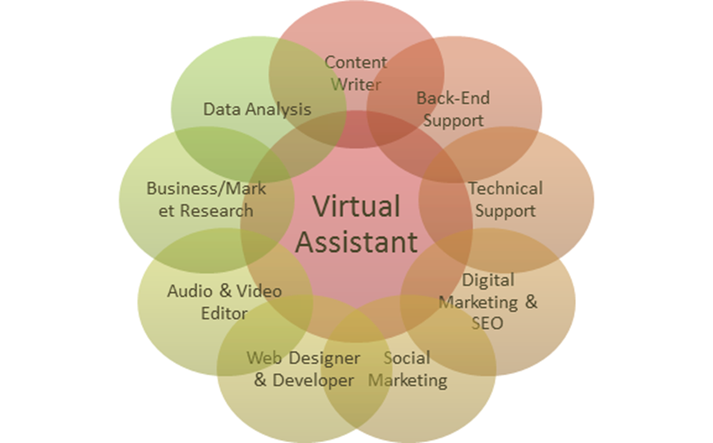
USE CASES
Customer Support and Service
Information Retrieval
Education
Entertainment and Media
Legal and Compliance

Slide 17
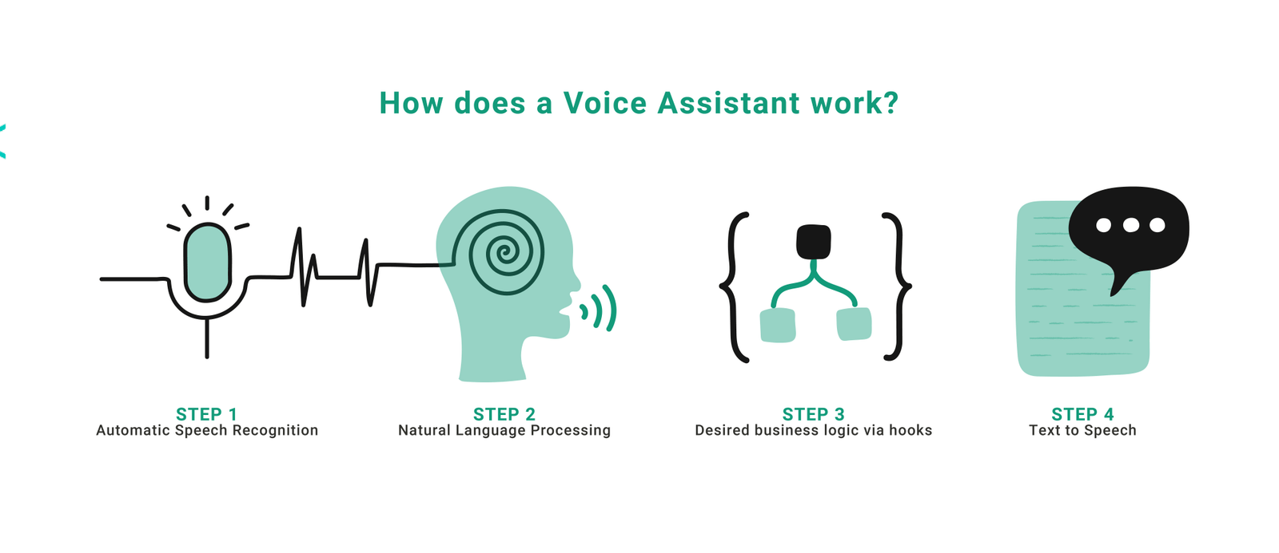
WORKING

Slide 18
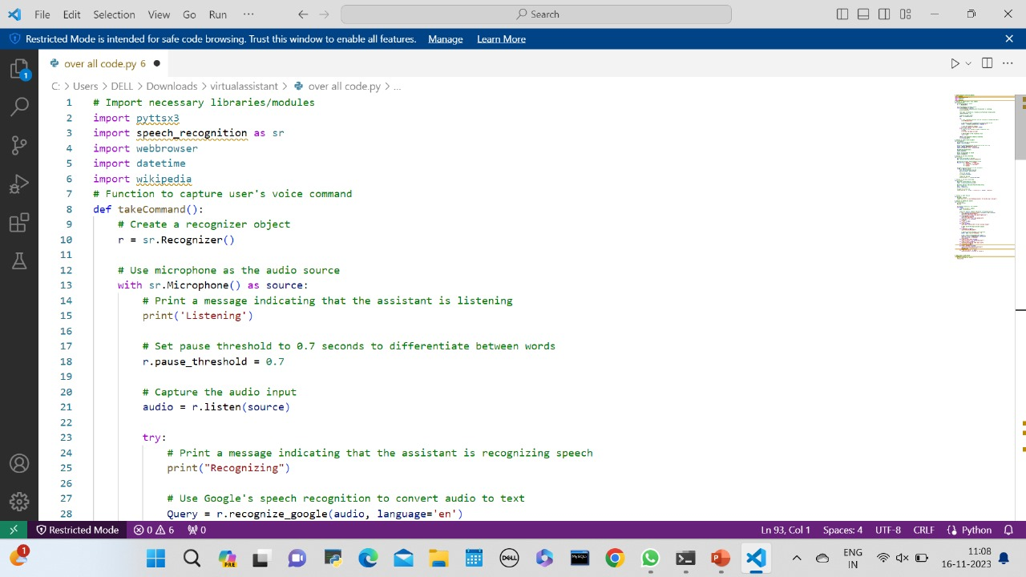
SAMPLE CODE

Slide 19
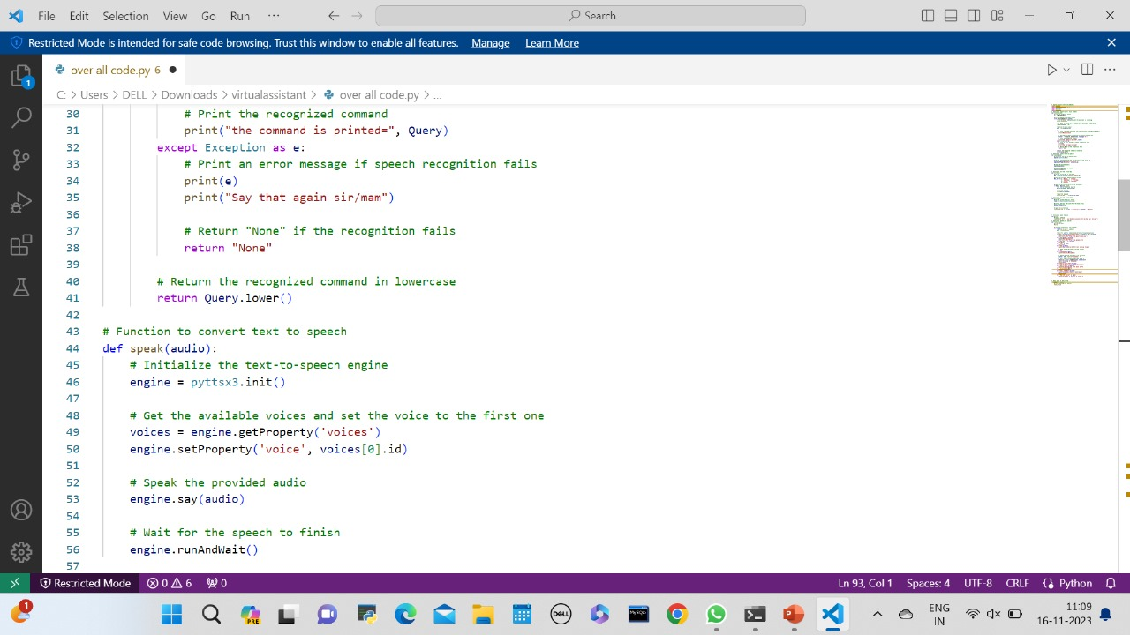

Slide 20
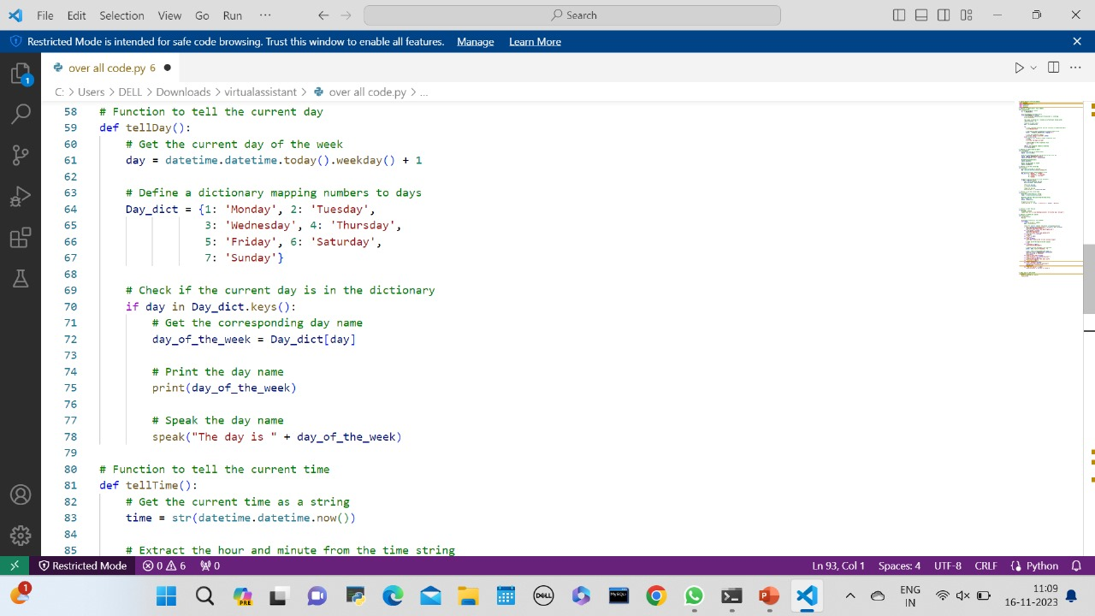

Slide 21
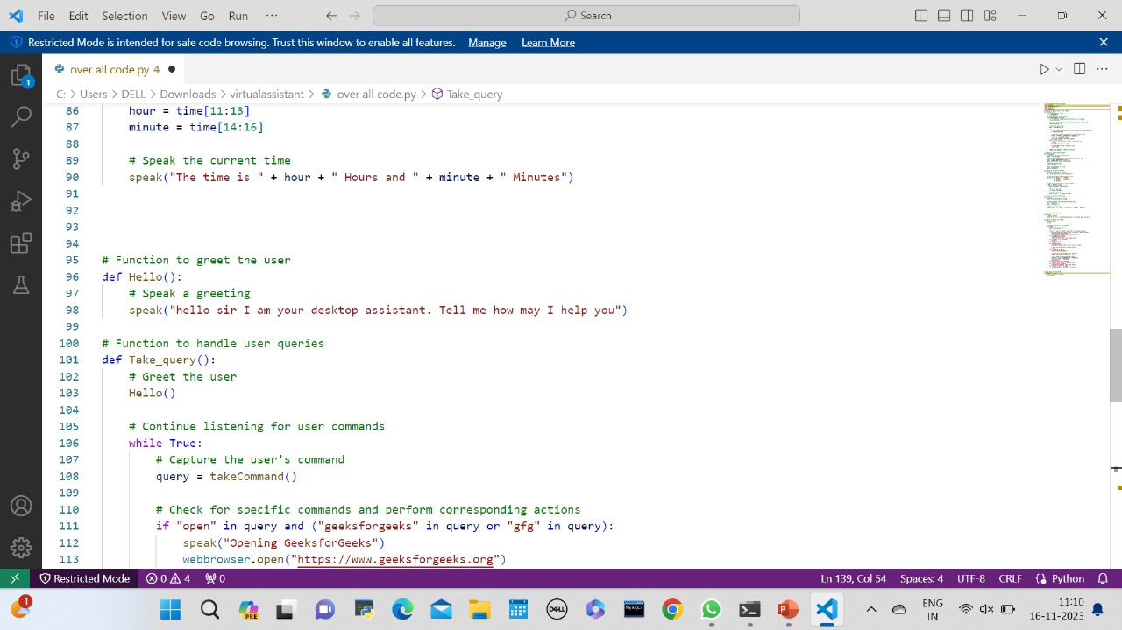

Slide 22
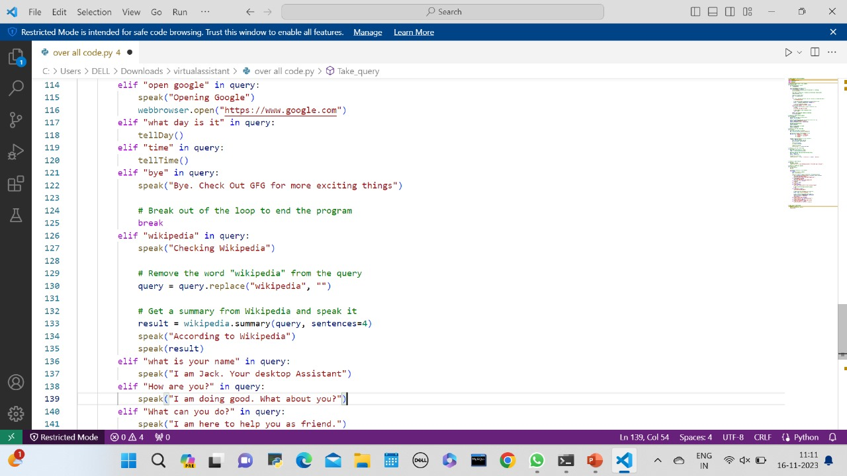

Slide 23
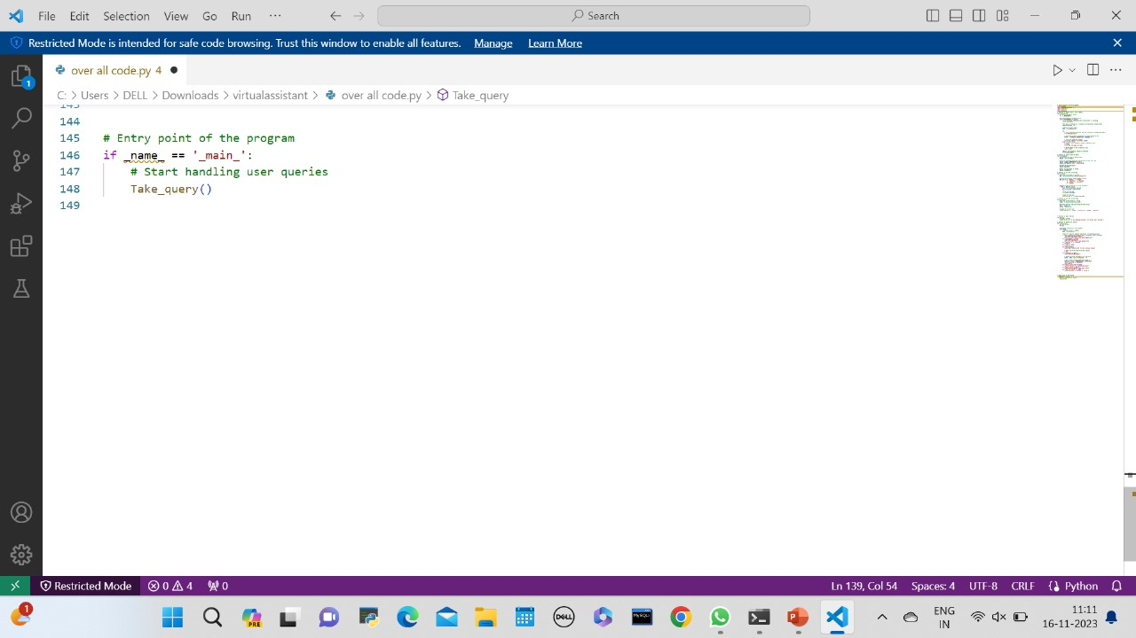

Slide 24
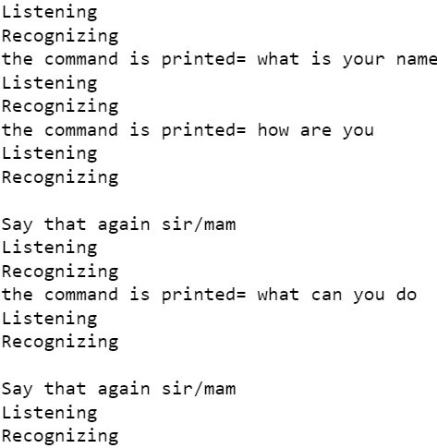
OUTPUT

Slide 25
CONCLUSION
In conclusion, the development of a virtual assistant represents a significant milestone in harnessing the power of artificial intelligence to enhance our daily lives. This project has demonstrated the potential of AI-driven technology to streamline tasks, improve efficiency, and create a more convenient and responsive user experience. As we navigate an ever-evolving digital landscape, virtual assistants offer a glimpse into the future, where human-computer interaction becomes more natural and seamless. However, it is crucial to remember that the journey of building a virtual assistant is an ongoing process, with continuous improvements and refinements required to meet user expectations and address new challenges. The promise of virtual assistants lies not just in their current capabilities, but in the limitless possibilities they hold for transforming the way we live and work. With further innovation and research, we can expect virtual assistants to play an increasingly vital role in shaping the way we interact with technology and each other, making our lives more efficient, productive, and enjoyable.

Slide 26
FUTURE ENHANCEMENT
For future enhancements, the project could focus on several areas:
Advanced NLP Capabilities: Enhance the natural language processing capabilities of the virtual assistant to understand and generate more nuanced and contextually rich responses.
Multimodal Interaction: Explore incorporating multimodal capabilities, such as integrating voice, images, or even gestures, to provide a more immersive and versatile user experience.
Integration with Emerging Technologies: Explore integration with emerging technologies like augmented reality (AR) or virtual reality (VR) to create innovative and immersive user interfaces.
Expanded Domain Expertise: Train the virtual assistant to handle a broader range of domains and industries, making it more versatile and applicable to diverse user needs.
Enhanced Security Measures: Strengthen security measures and privacy considerations to address potential vulnerabilities and ensure the safe handling of user data.
Community and Developer Engagement: Foster a community around the virtual assistant project to encourage collaboration, contributions, and the development of additional features or integrations.
Accessibility Features: Integrate accessibility features to ensure the virtual assistant is usable by individuals with diverse needs and abilities.
Global Language Support: Extend language support to cater to a more diverse user base, enabling the virtual assistant to communicate effectively in multiple languages.

Slide 27
Any Queries?

Slide 28
Thankyou!

